Slide 1
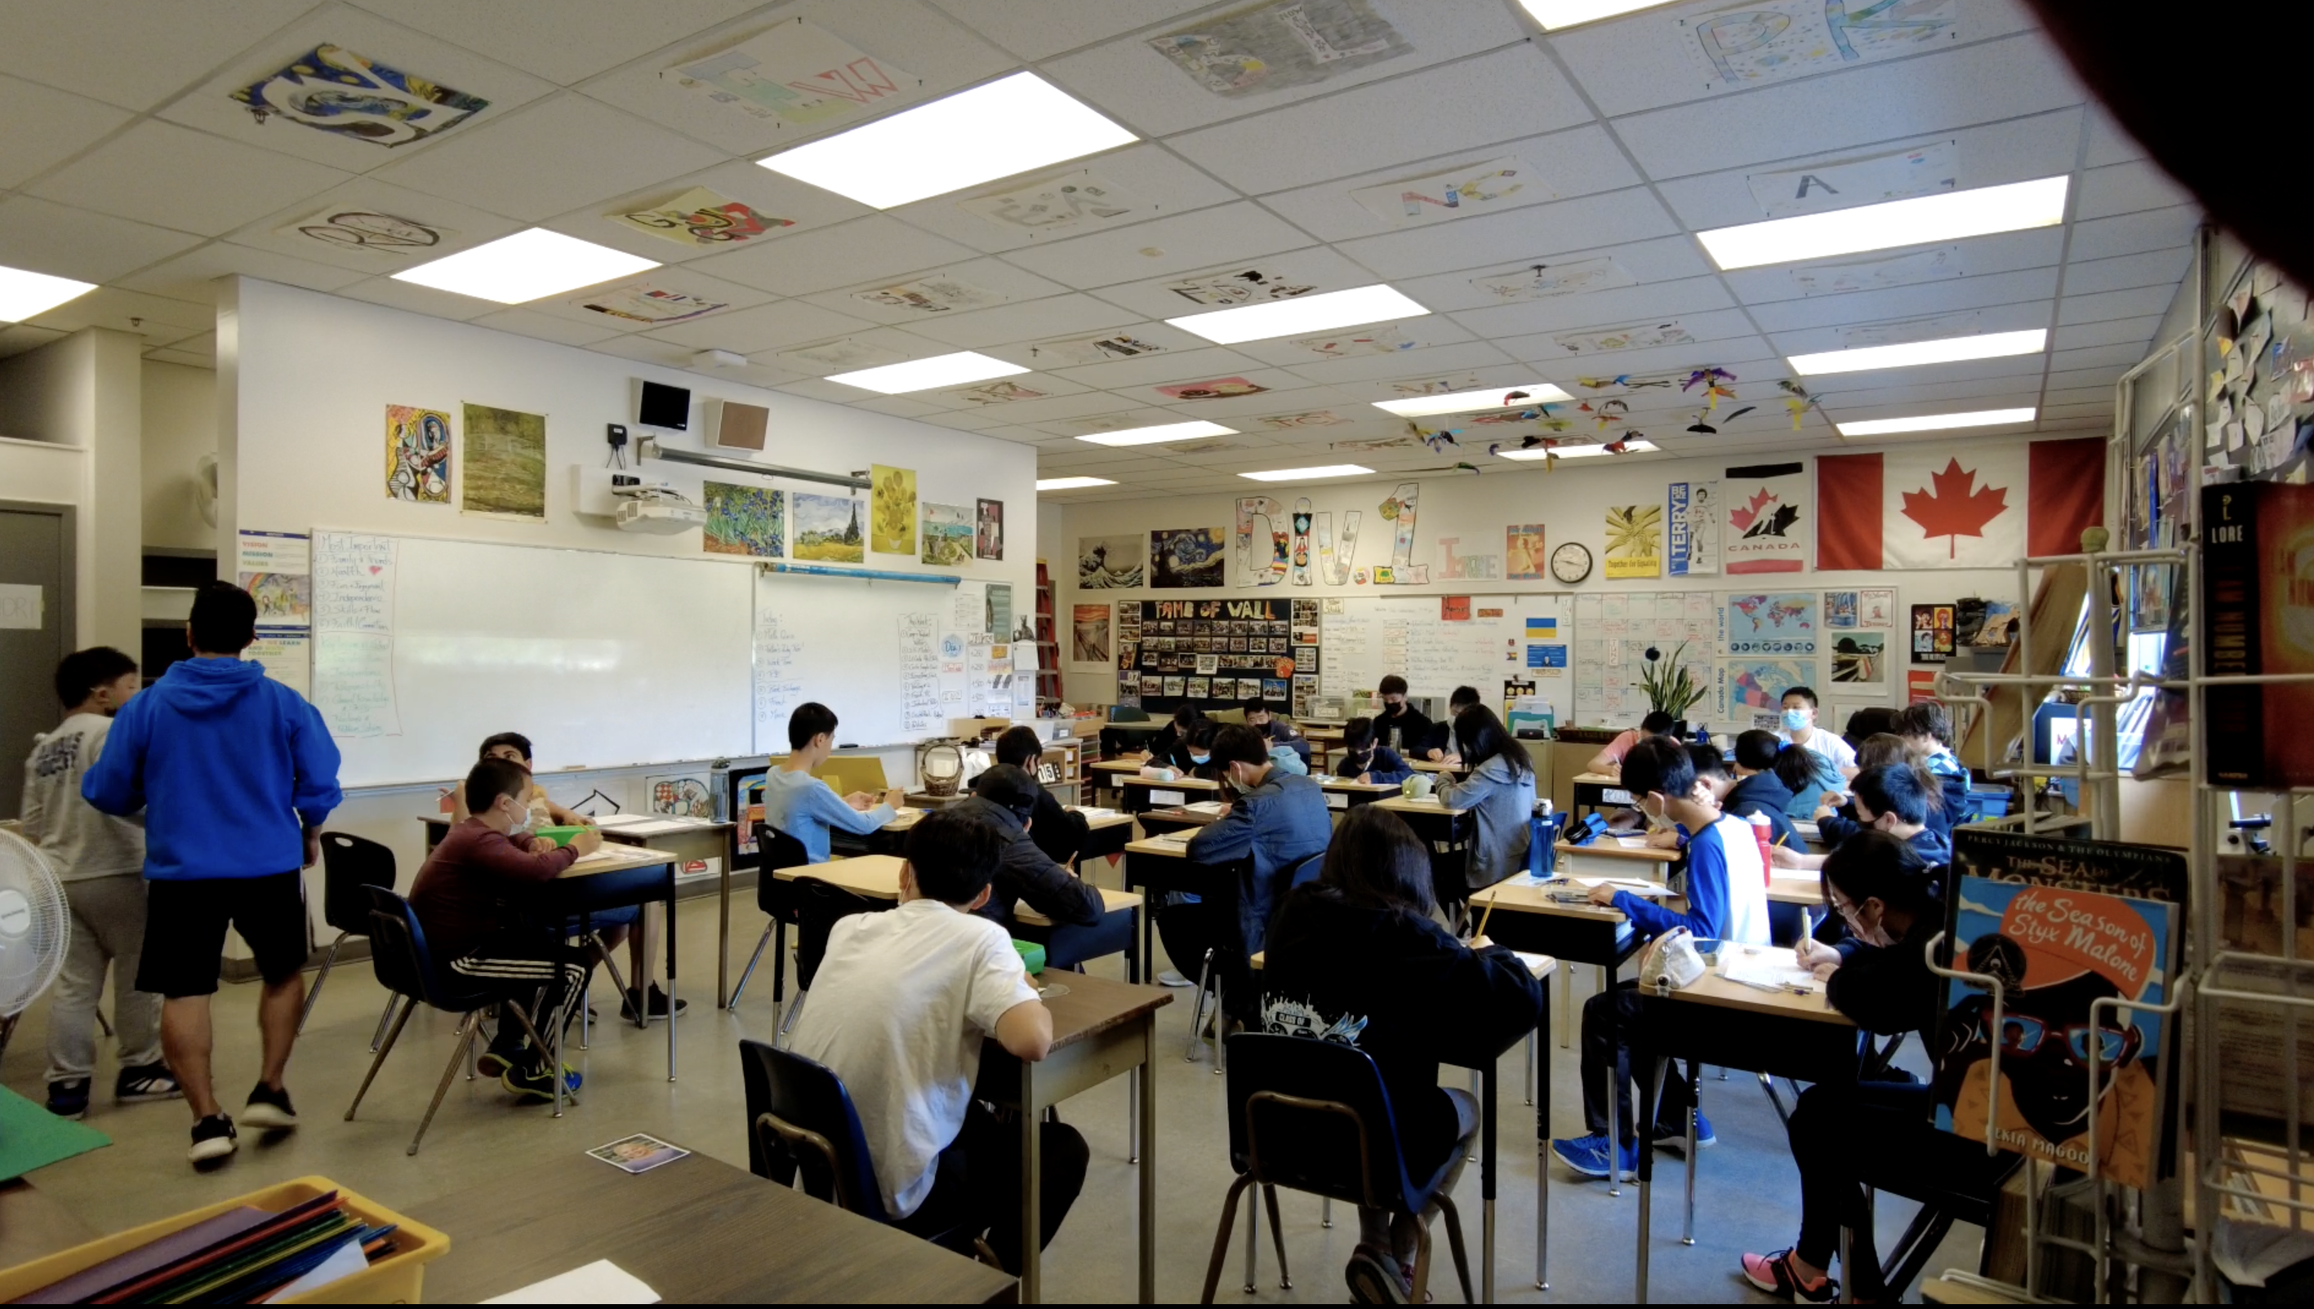
Why you are a student in school:
Very simply, school is preparing you for being an adult in the world.

Slide 2
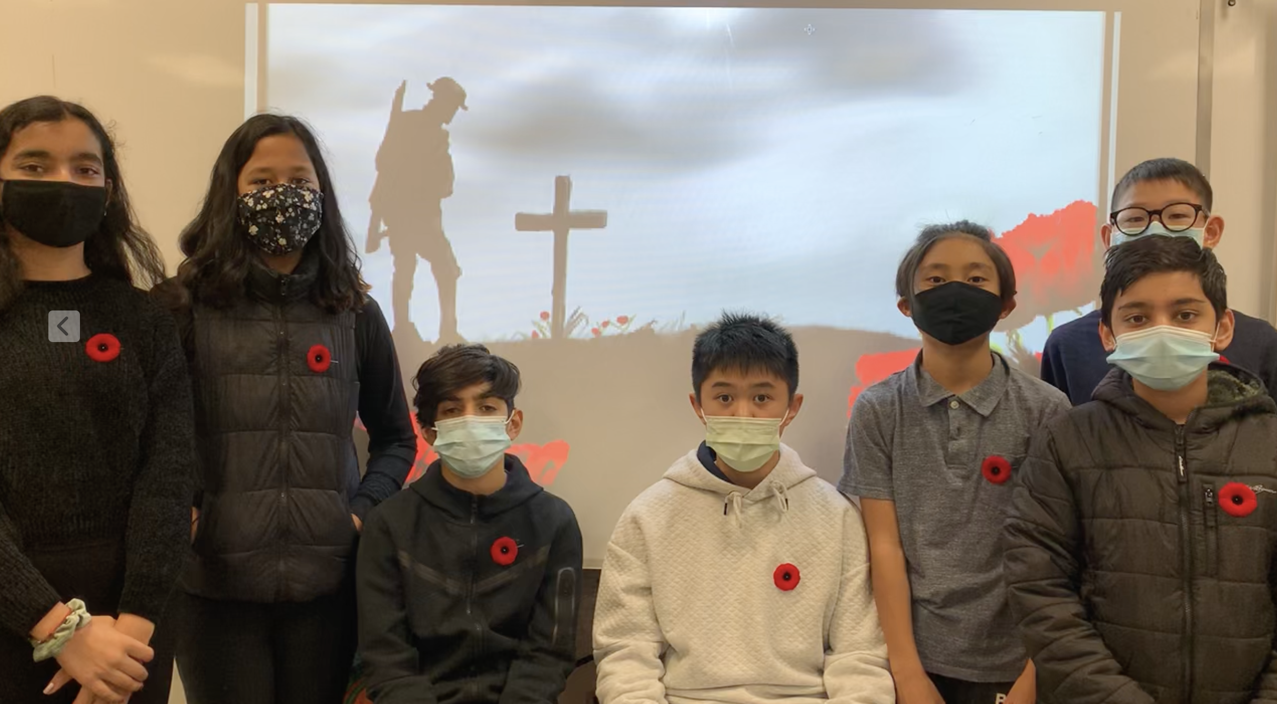
In school, you learn some key skills that are difficult to learn on your own:
1) Personal Responsibility for your learning and behaviour in society.

Slide 3
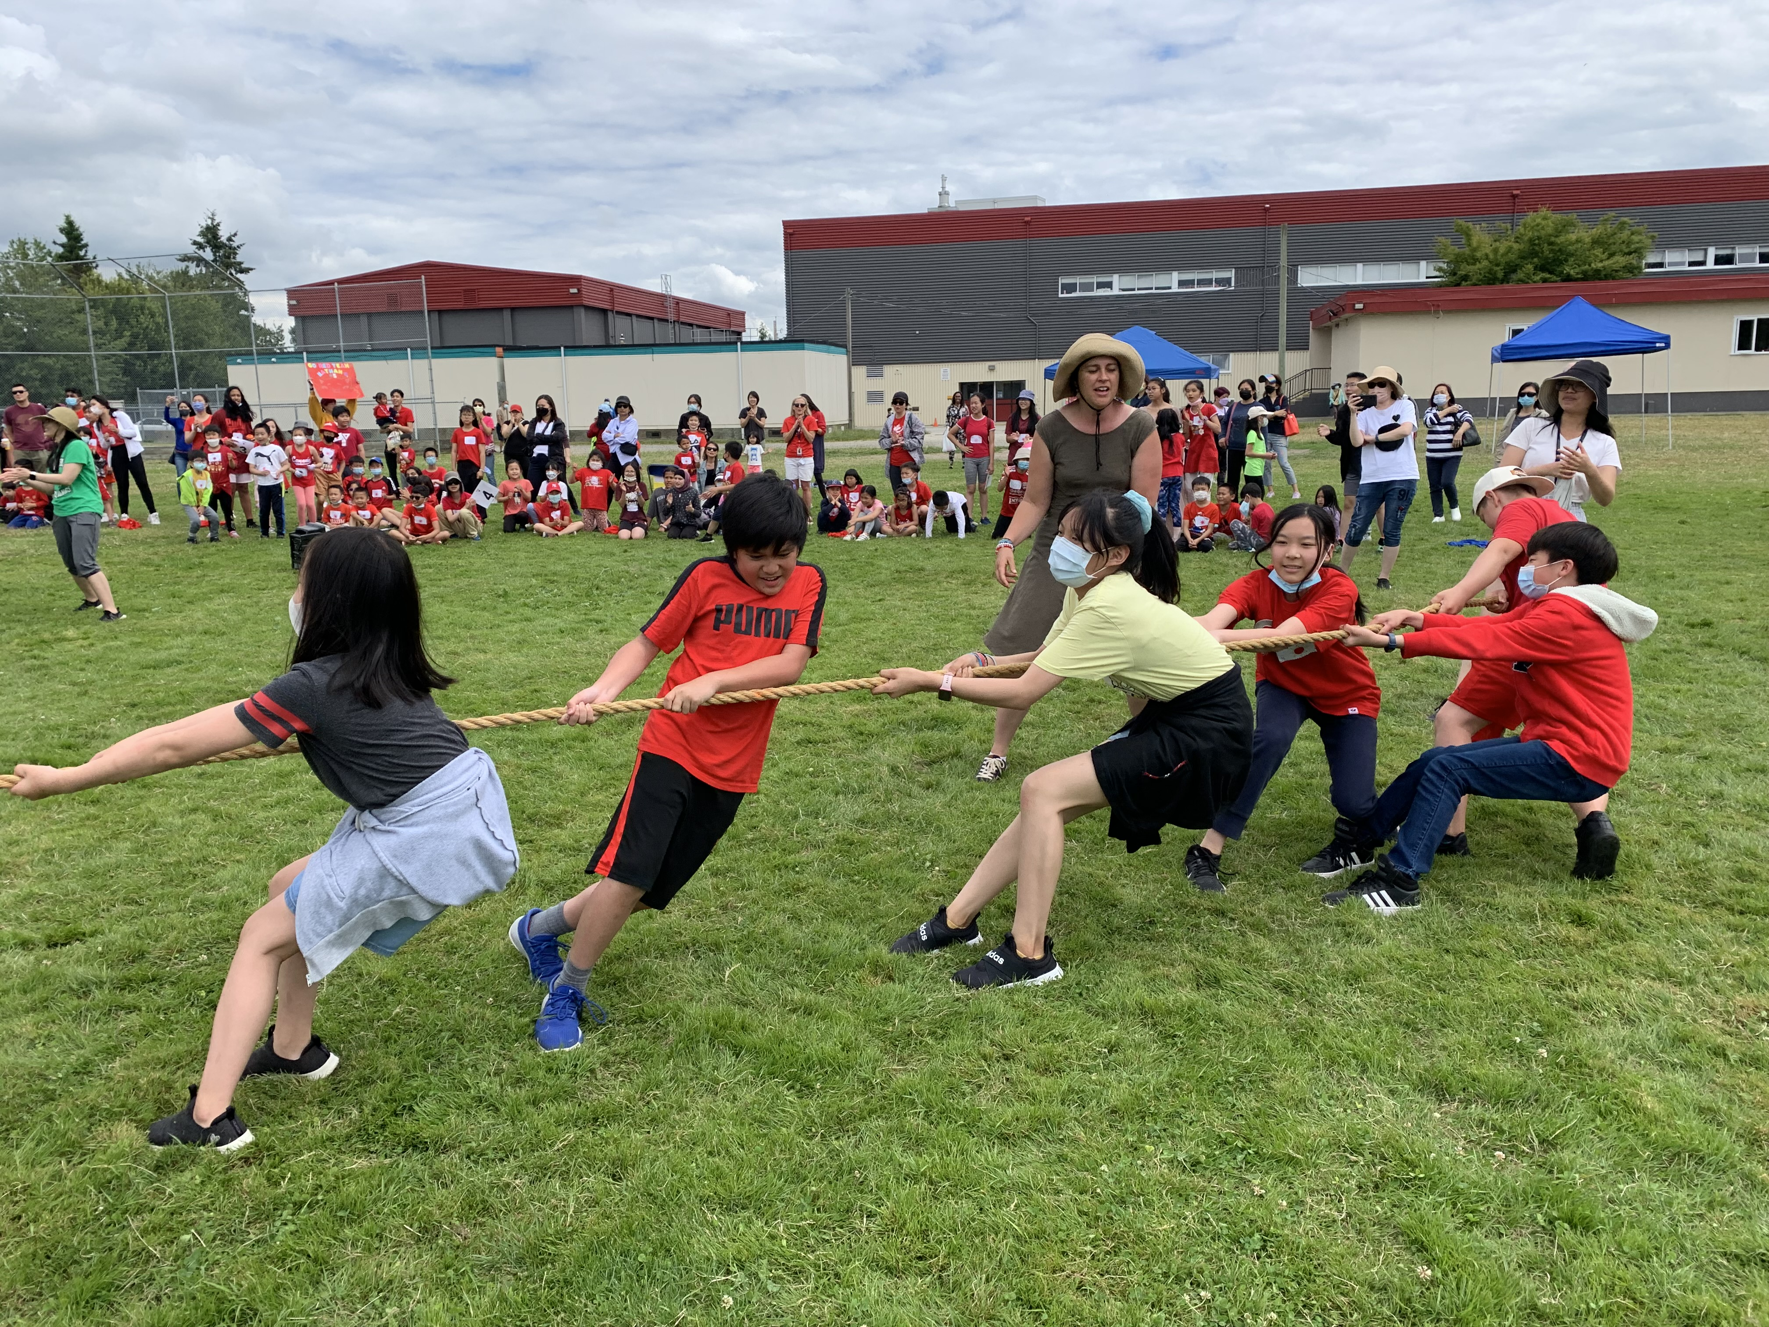
2) Social Responsibility to your classmates and school community. No one lives alone in their lives.

Slide 4
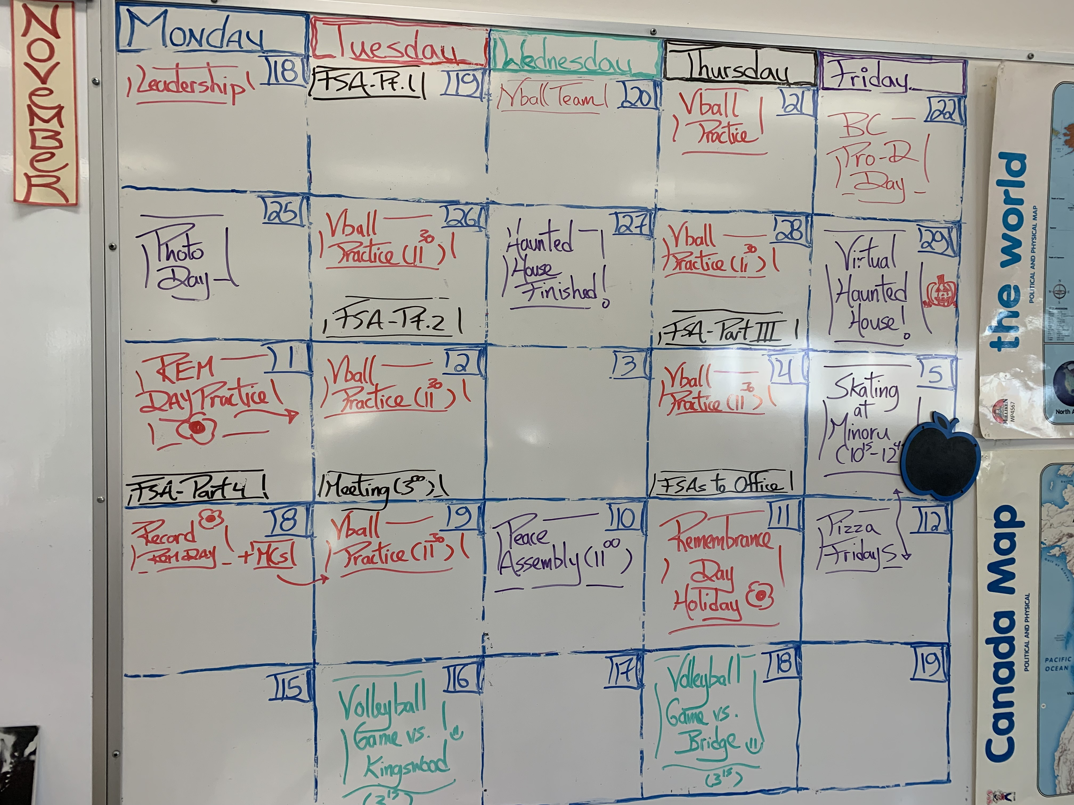
3) Managing your time, your learning, and your hobbies.

Slide 5
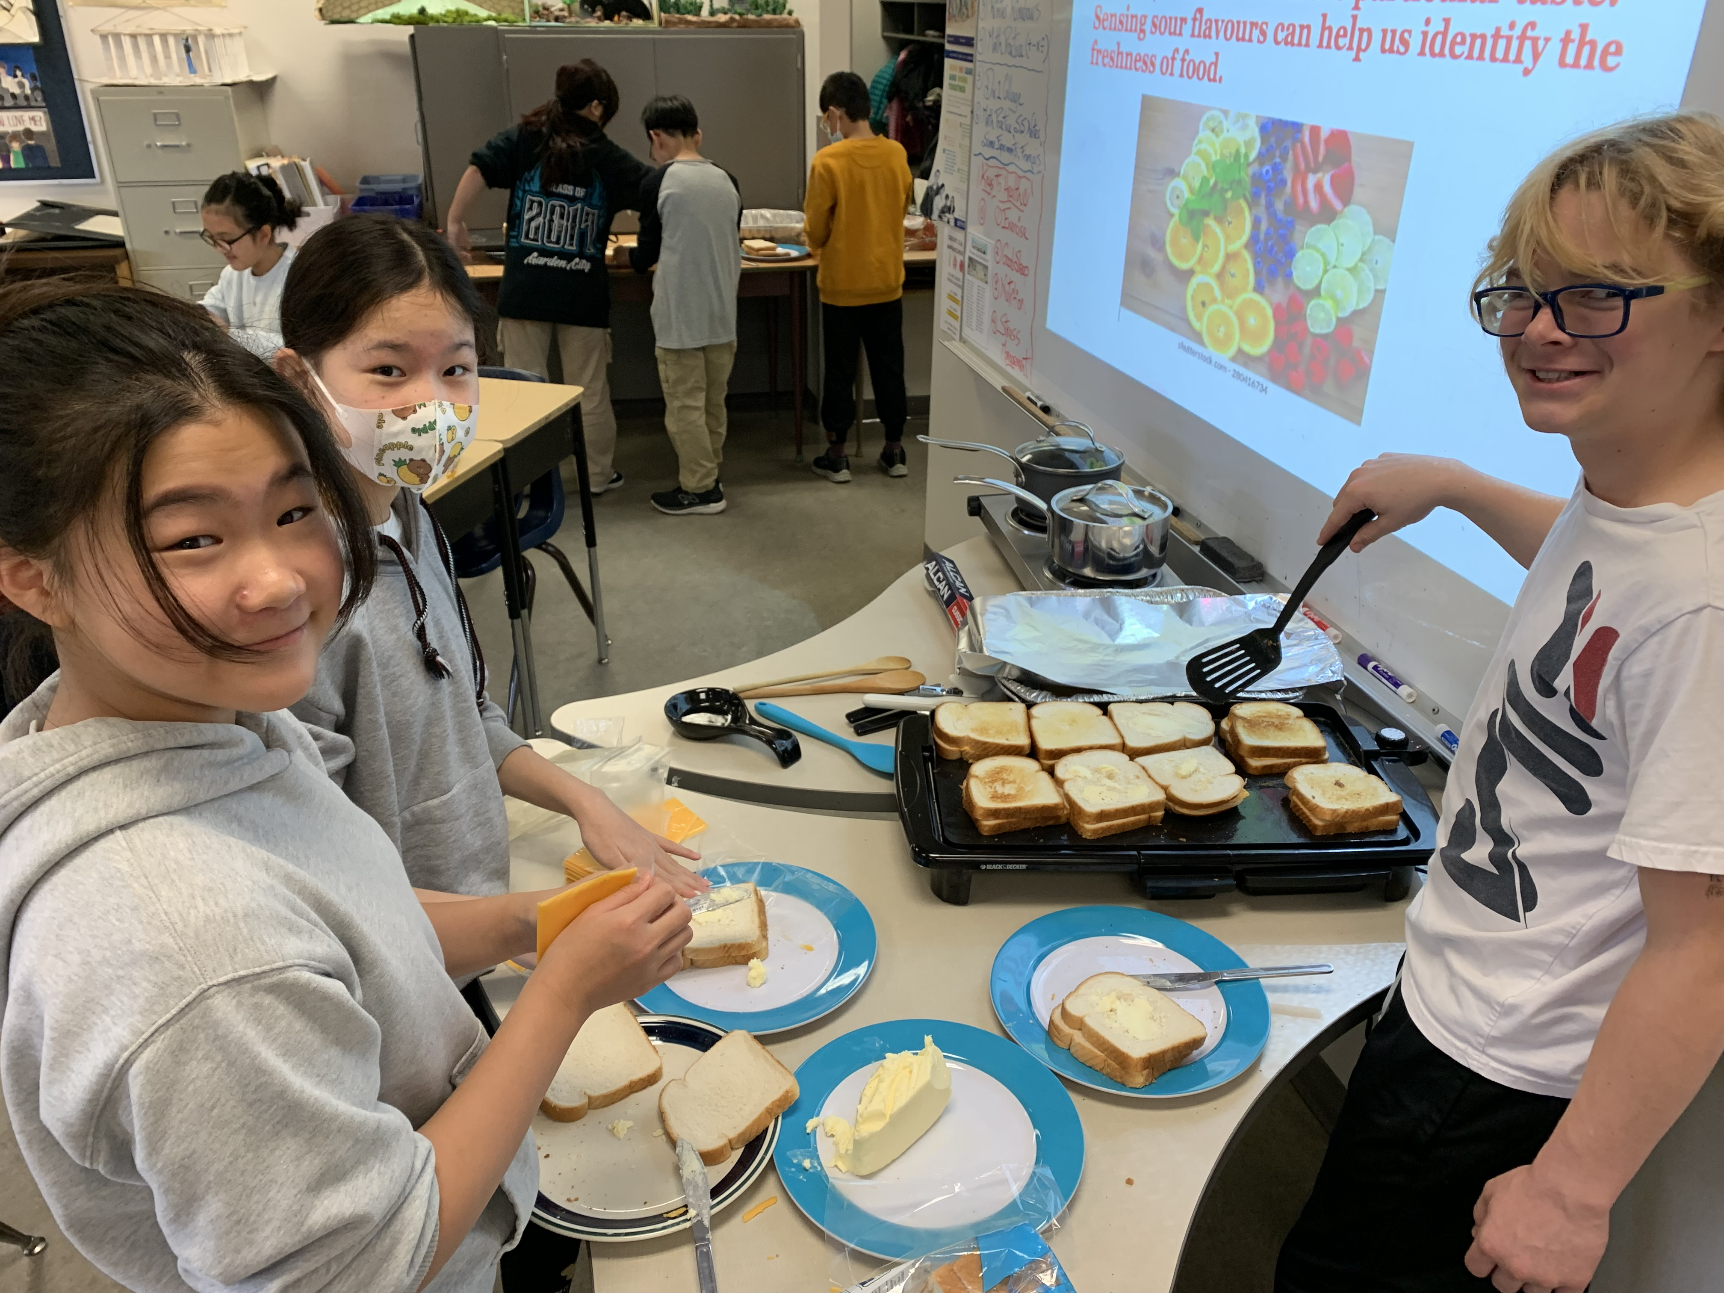
4) communicating effectively while Trying new things and Learning together.

Slide 6
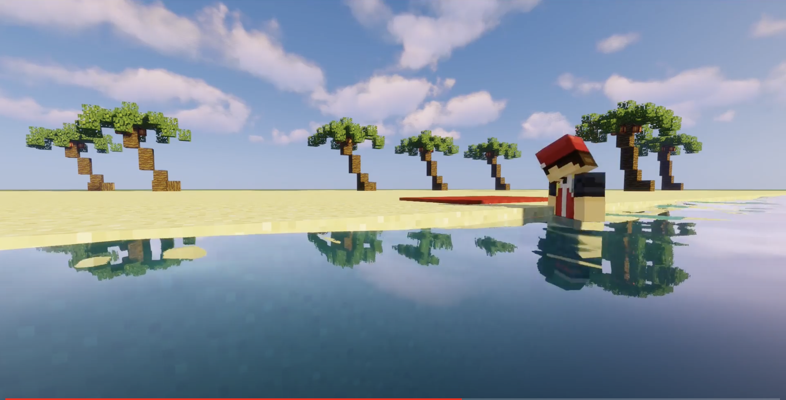
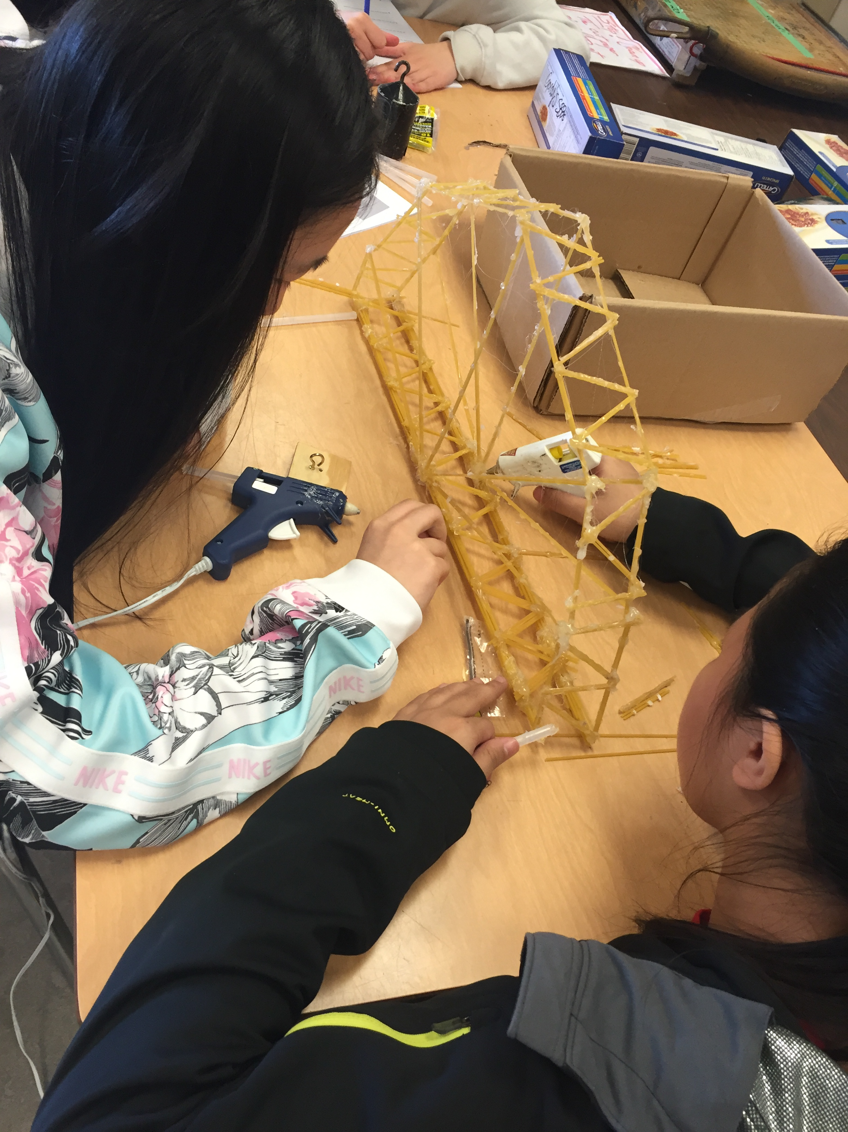
5) thinking about ways to learn and Improve.

Slide 7
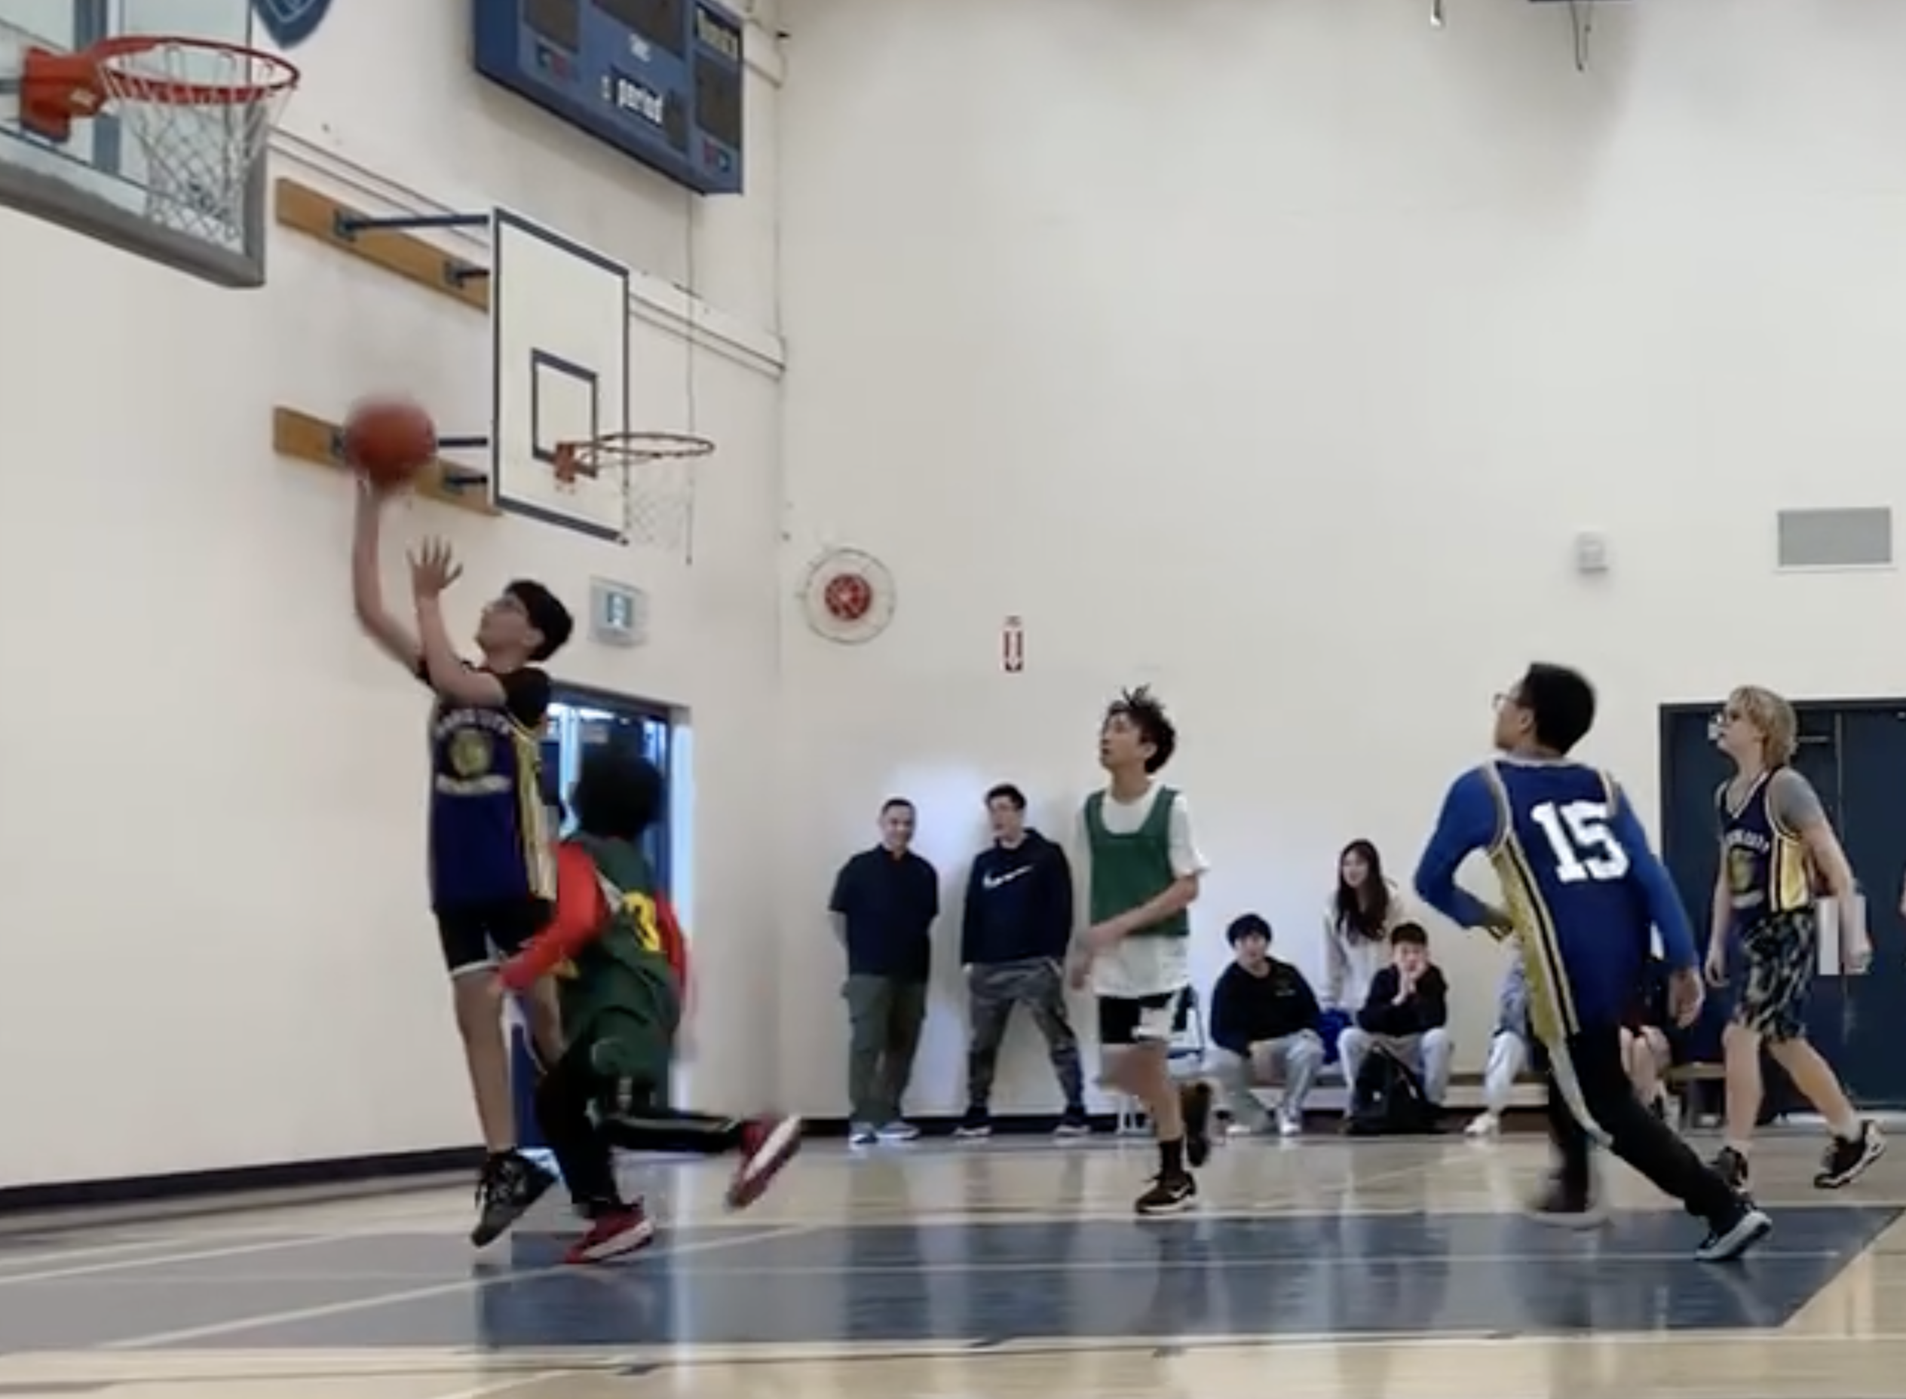
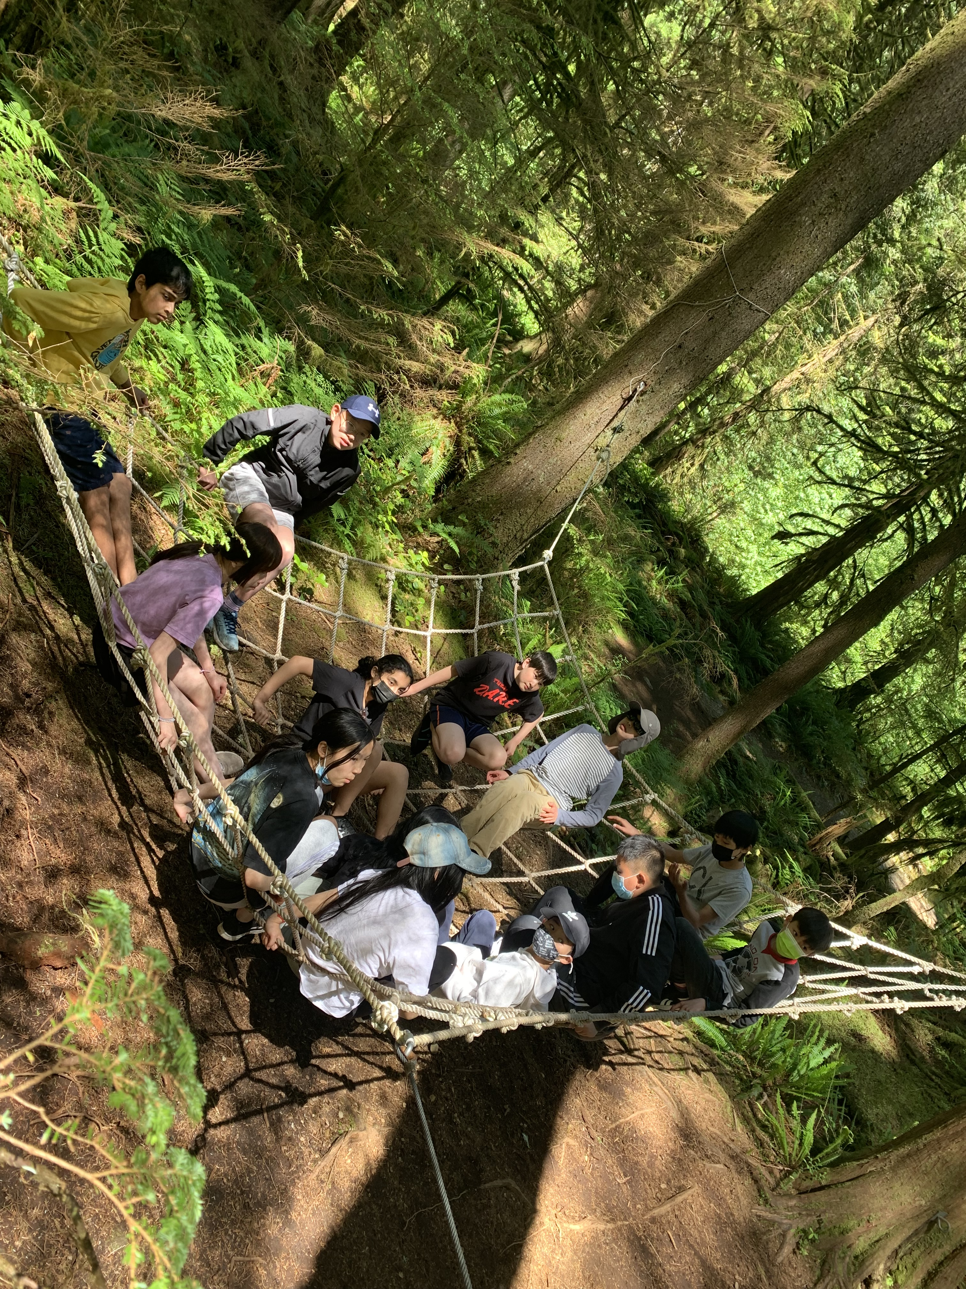
6) Building your resilience and your ability to solve problems in many forms.

