Slide 1
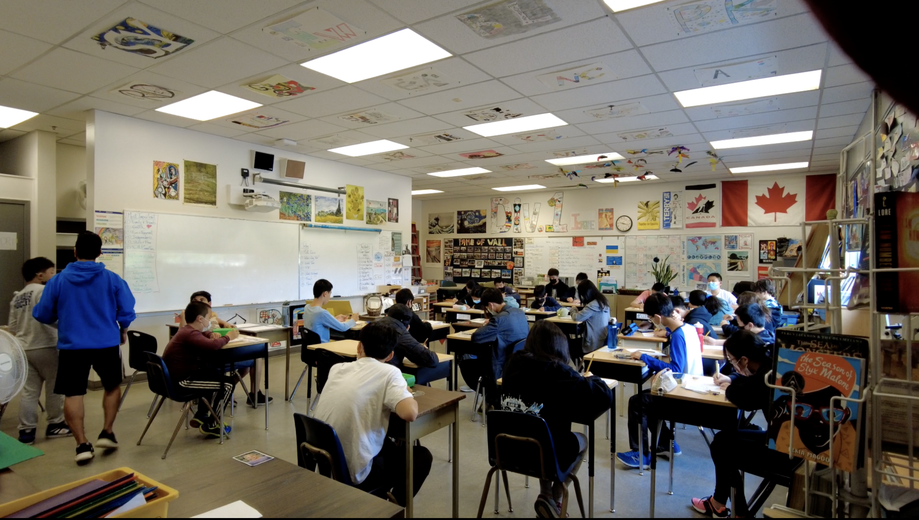
Why you are a student in school:
Very simply, school is preparing you for being an adult in the world.

Slide 2
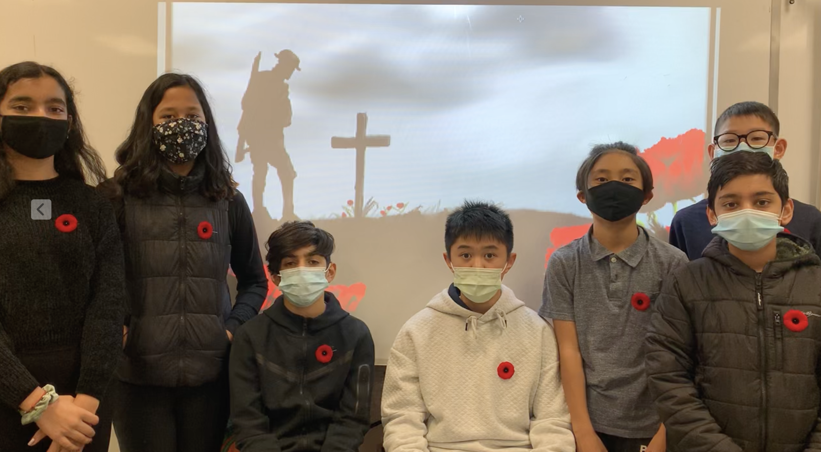
In school, you learn some key skills that are difficult to learn on your own:
1) You have a Personal Responsibility for your learning and behaviour in society.

Slide 3

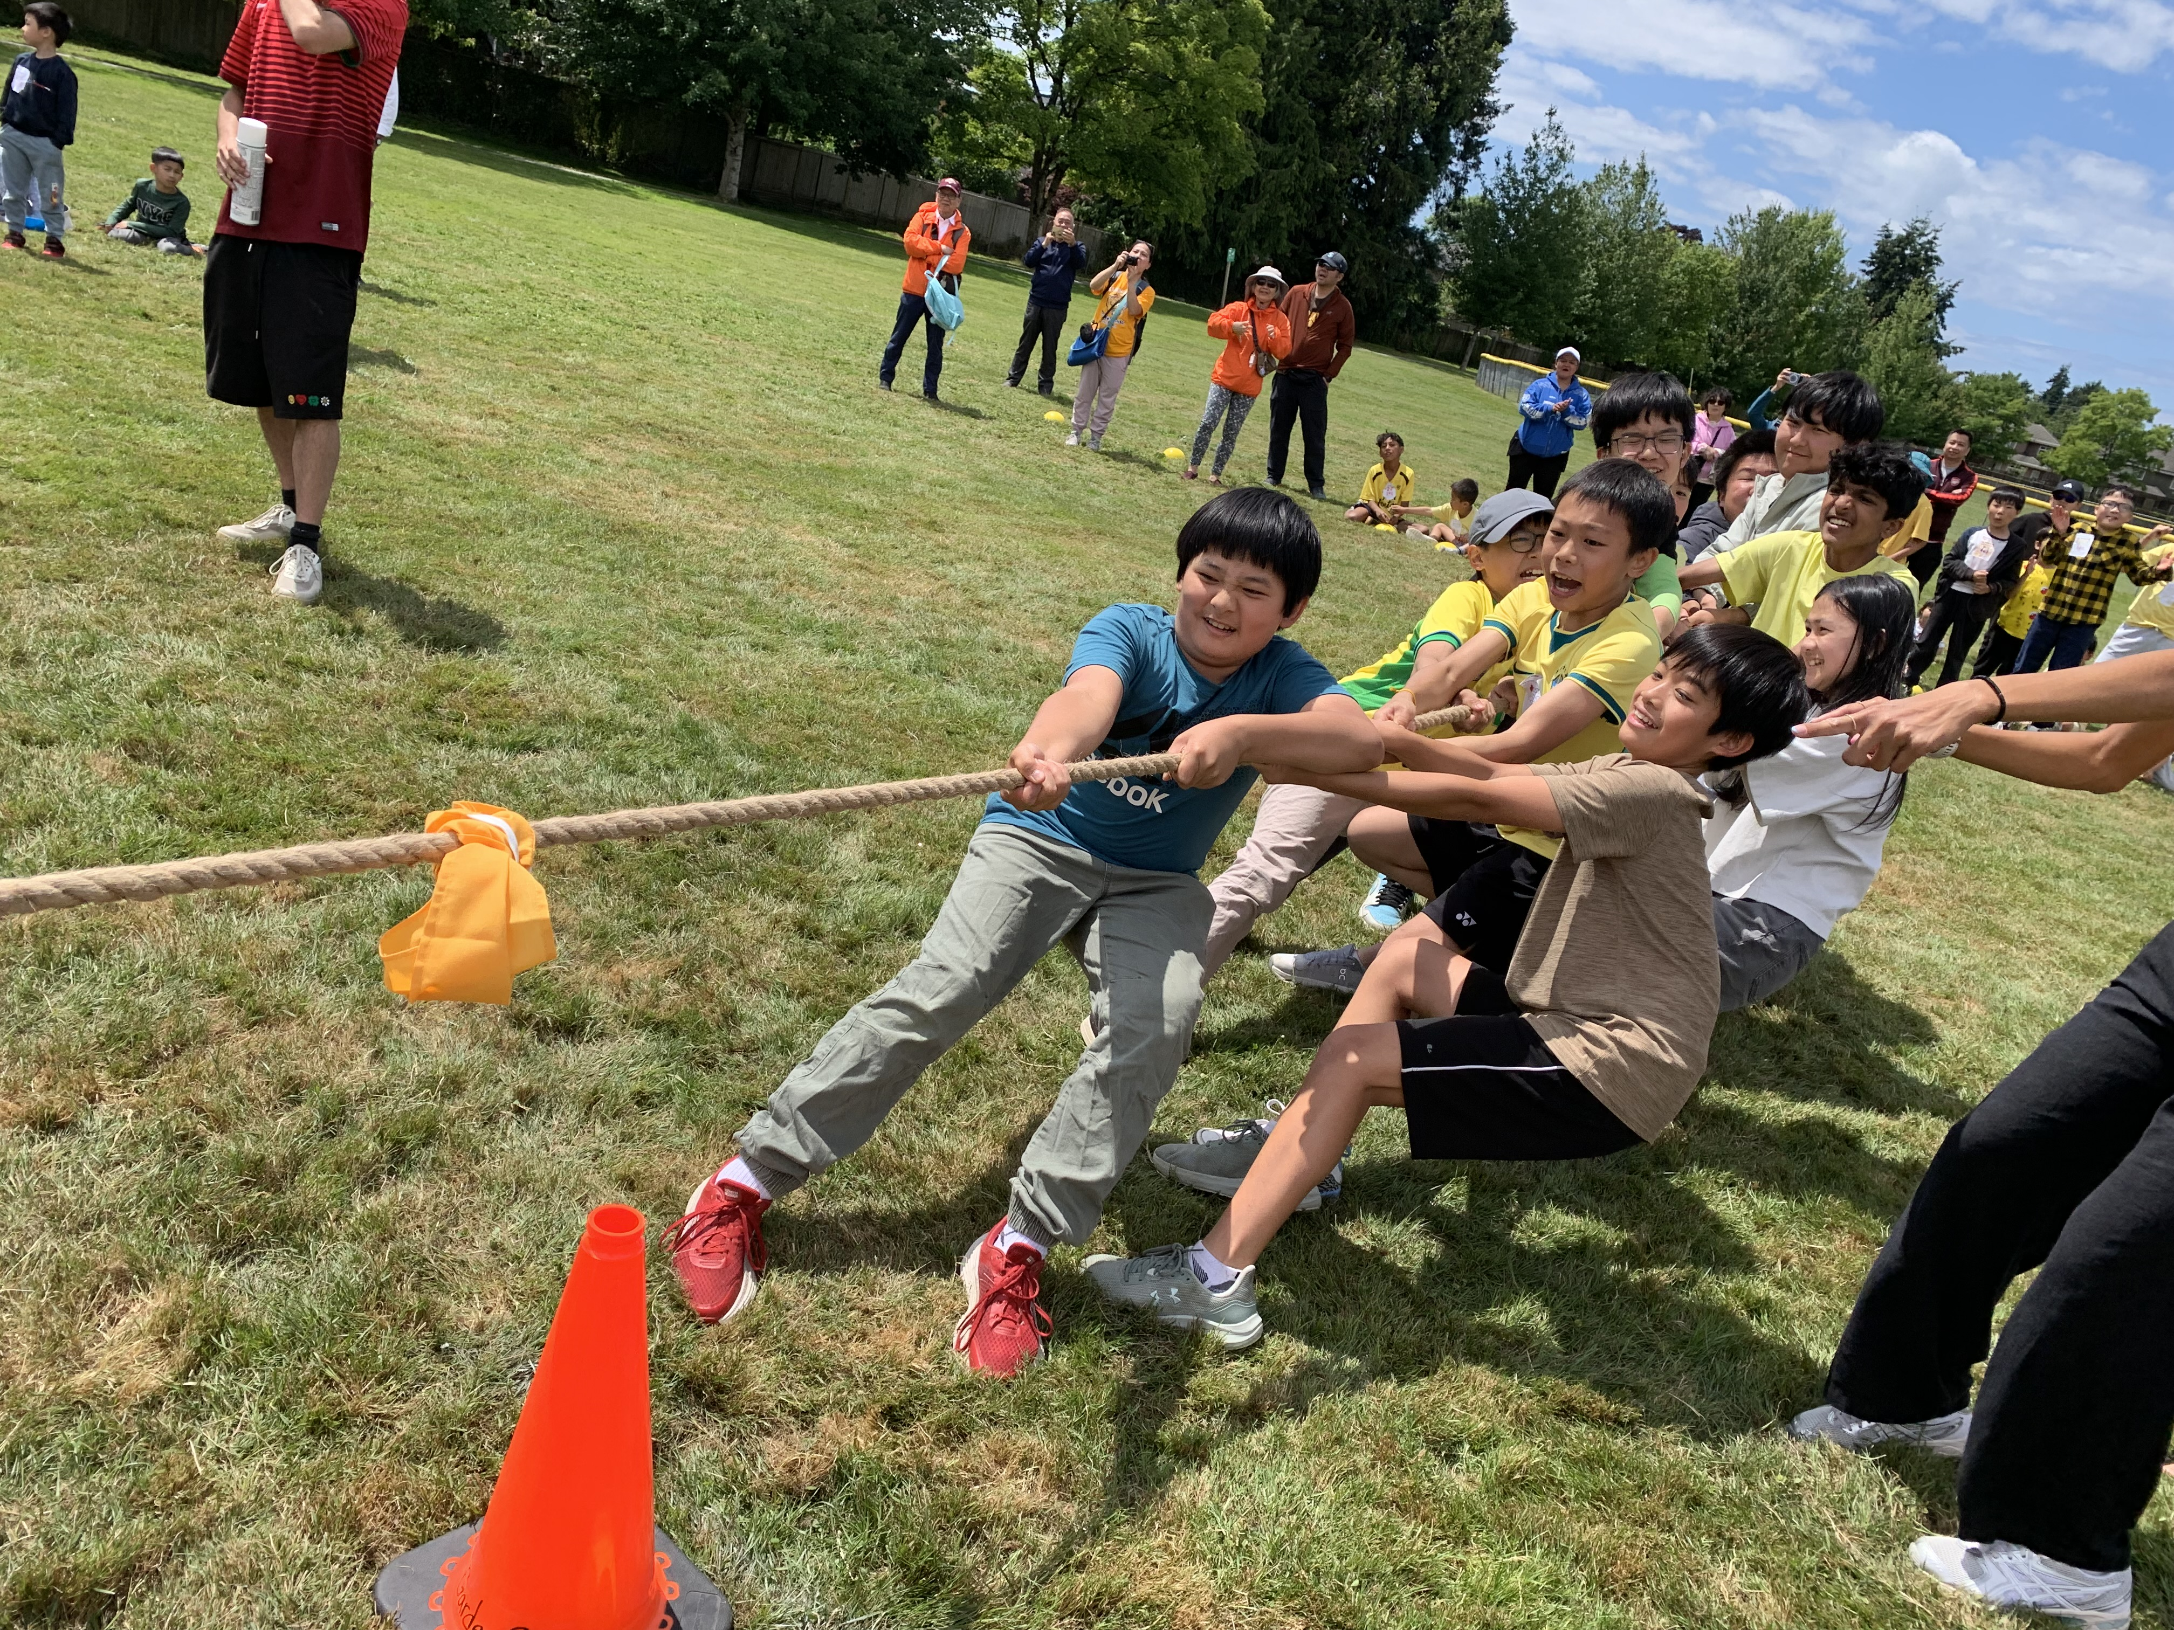
2) You have a Social Responsibility to your classmates and school community. No one lives alone in their lives.

Slide 4
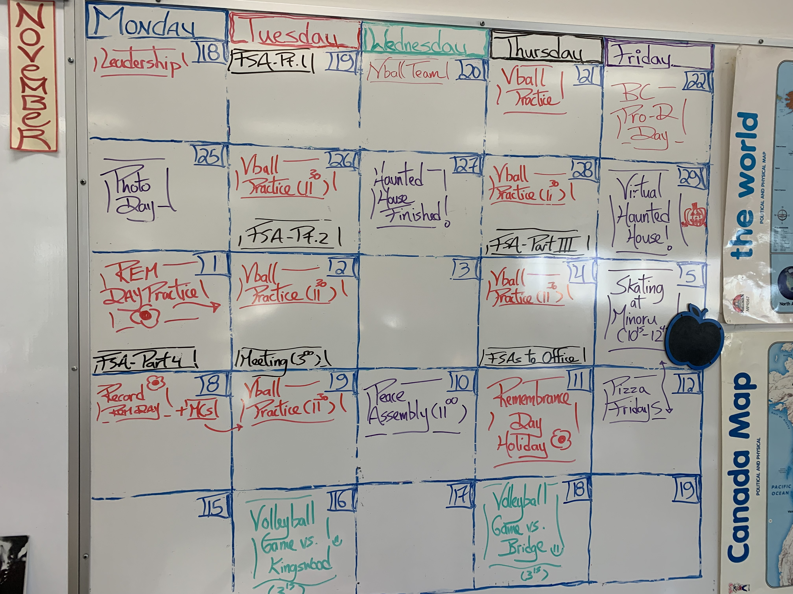
3) You need to learn to manage your time, your learning, and your hobbies.

Slide 5
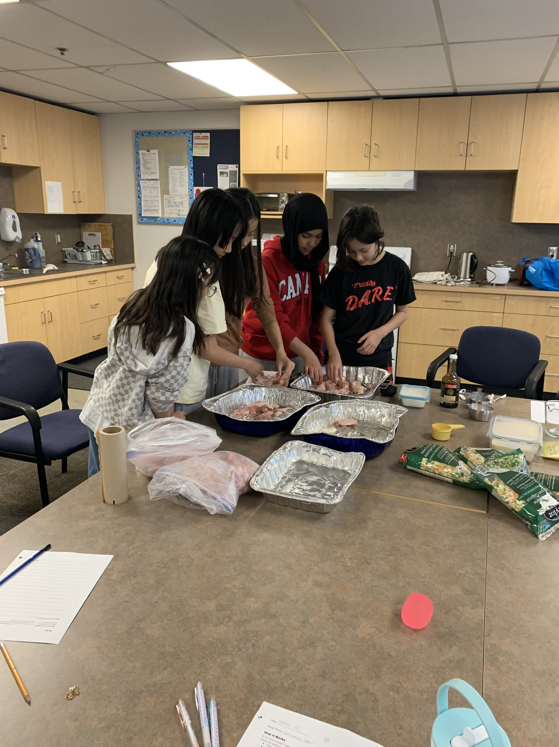
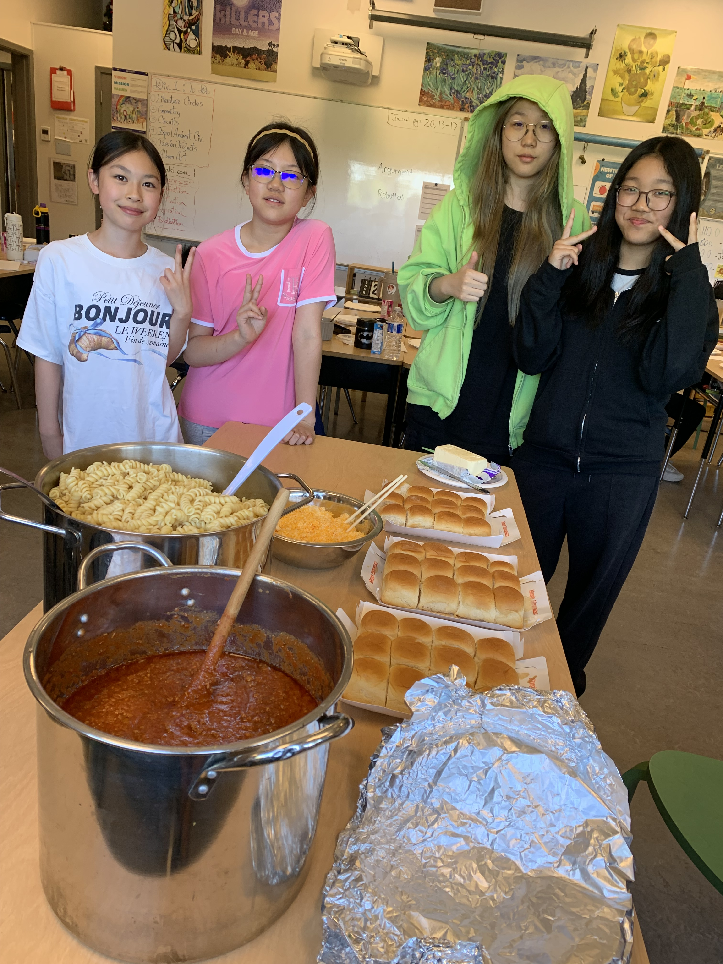
4) You learn to communicate effectively while Trying new things and Learning together.

Slide 6
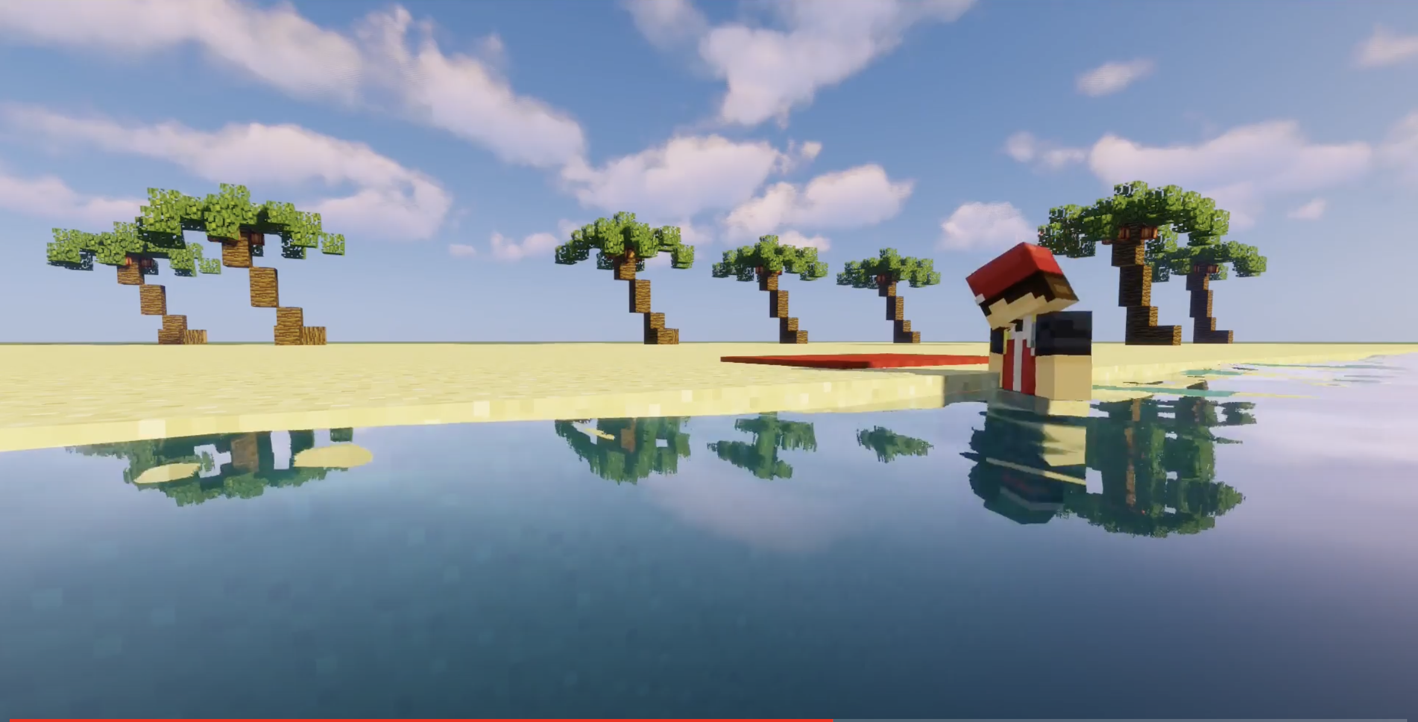
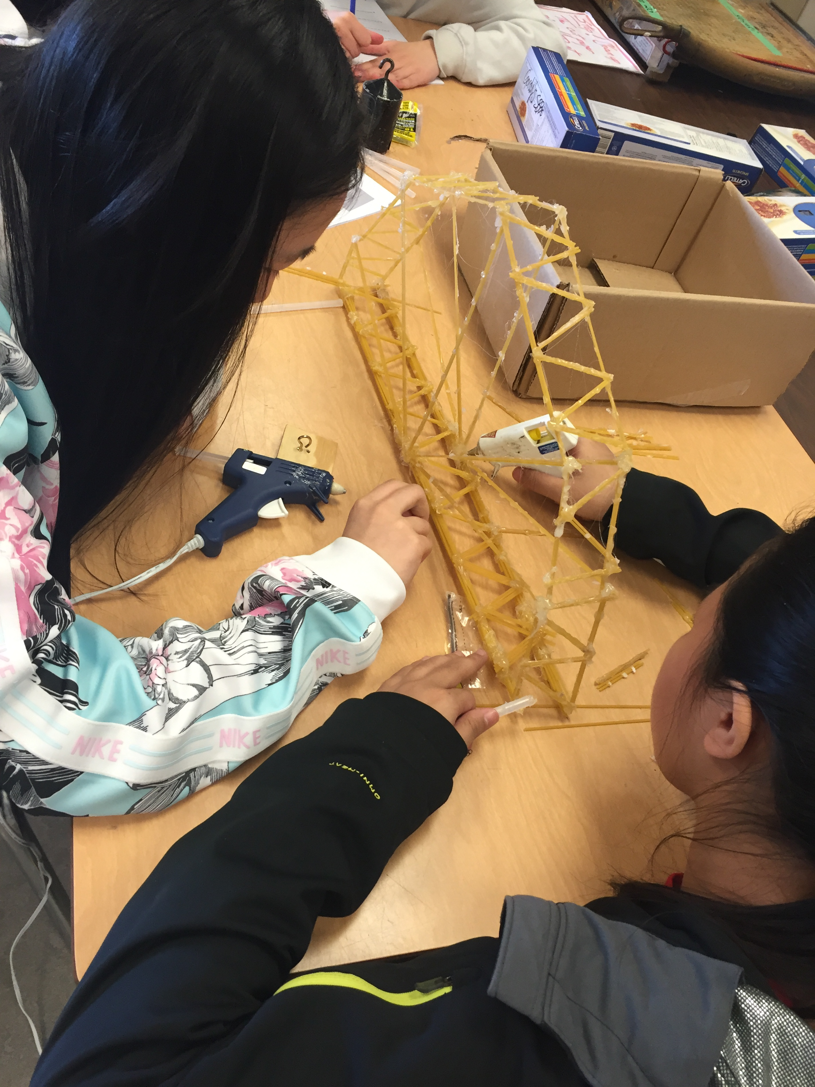
5) We think about new ways to learn and Improve.

Slide 7
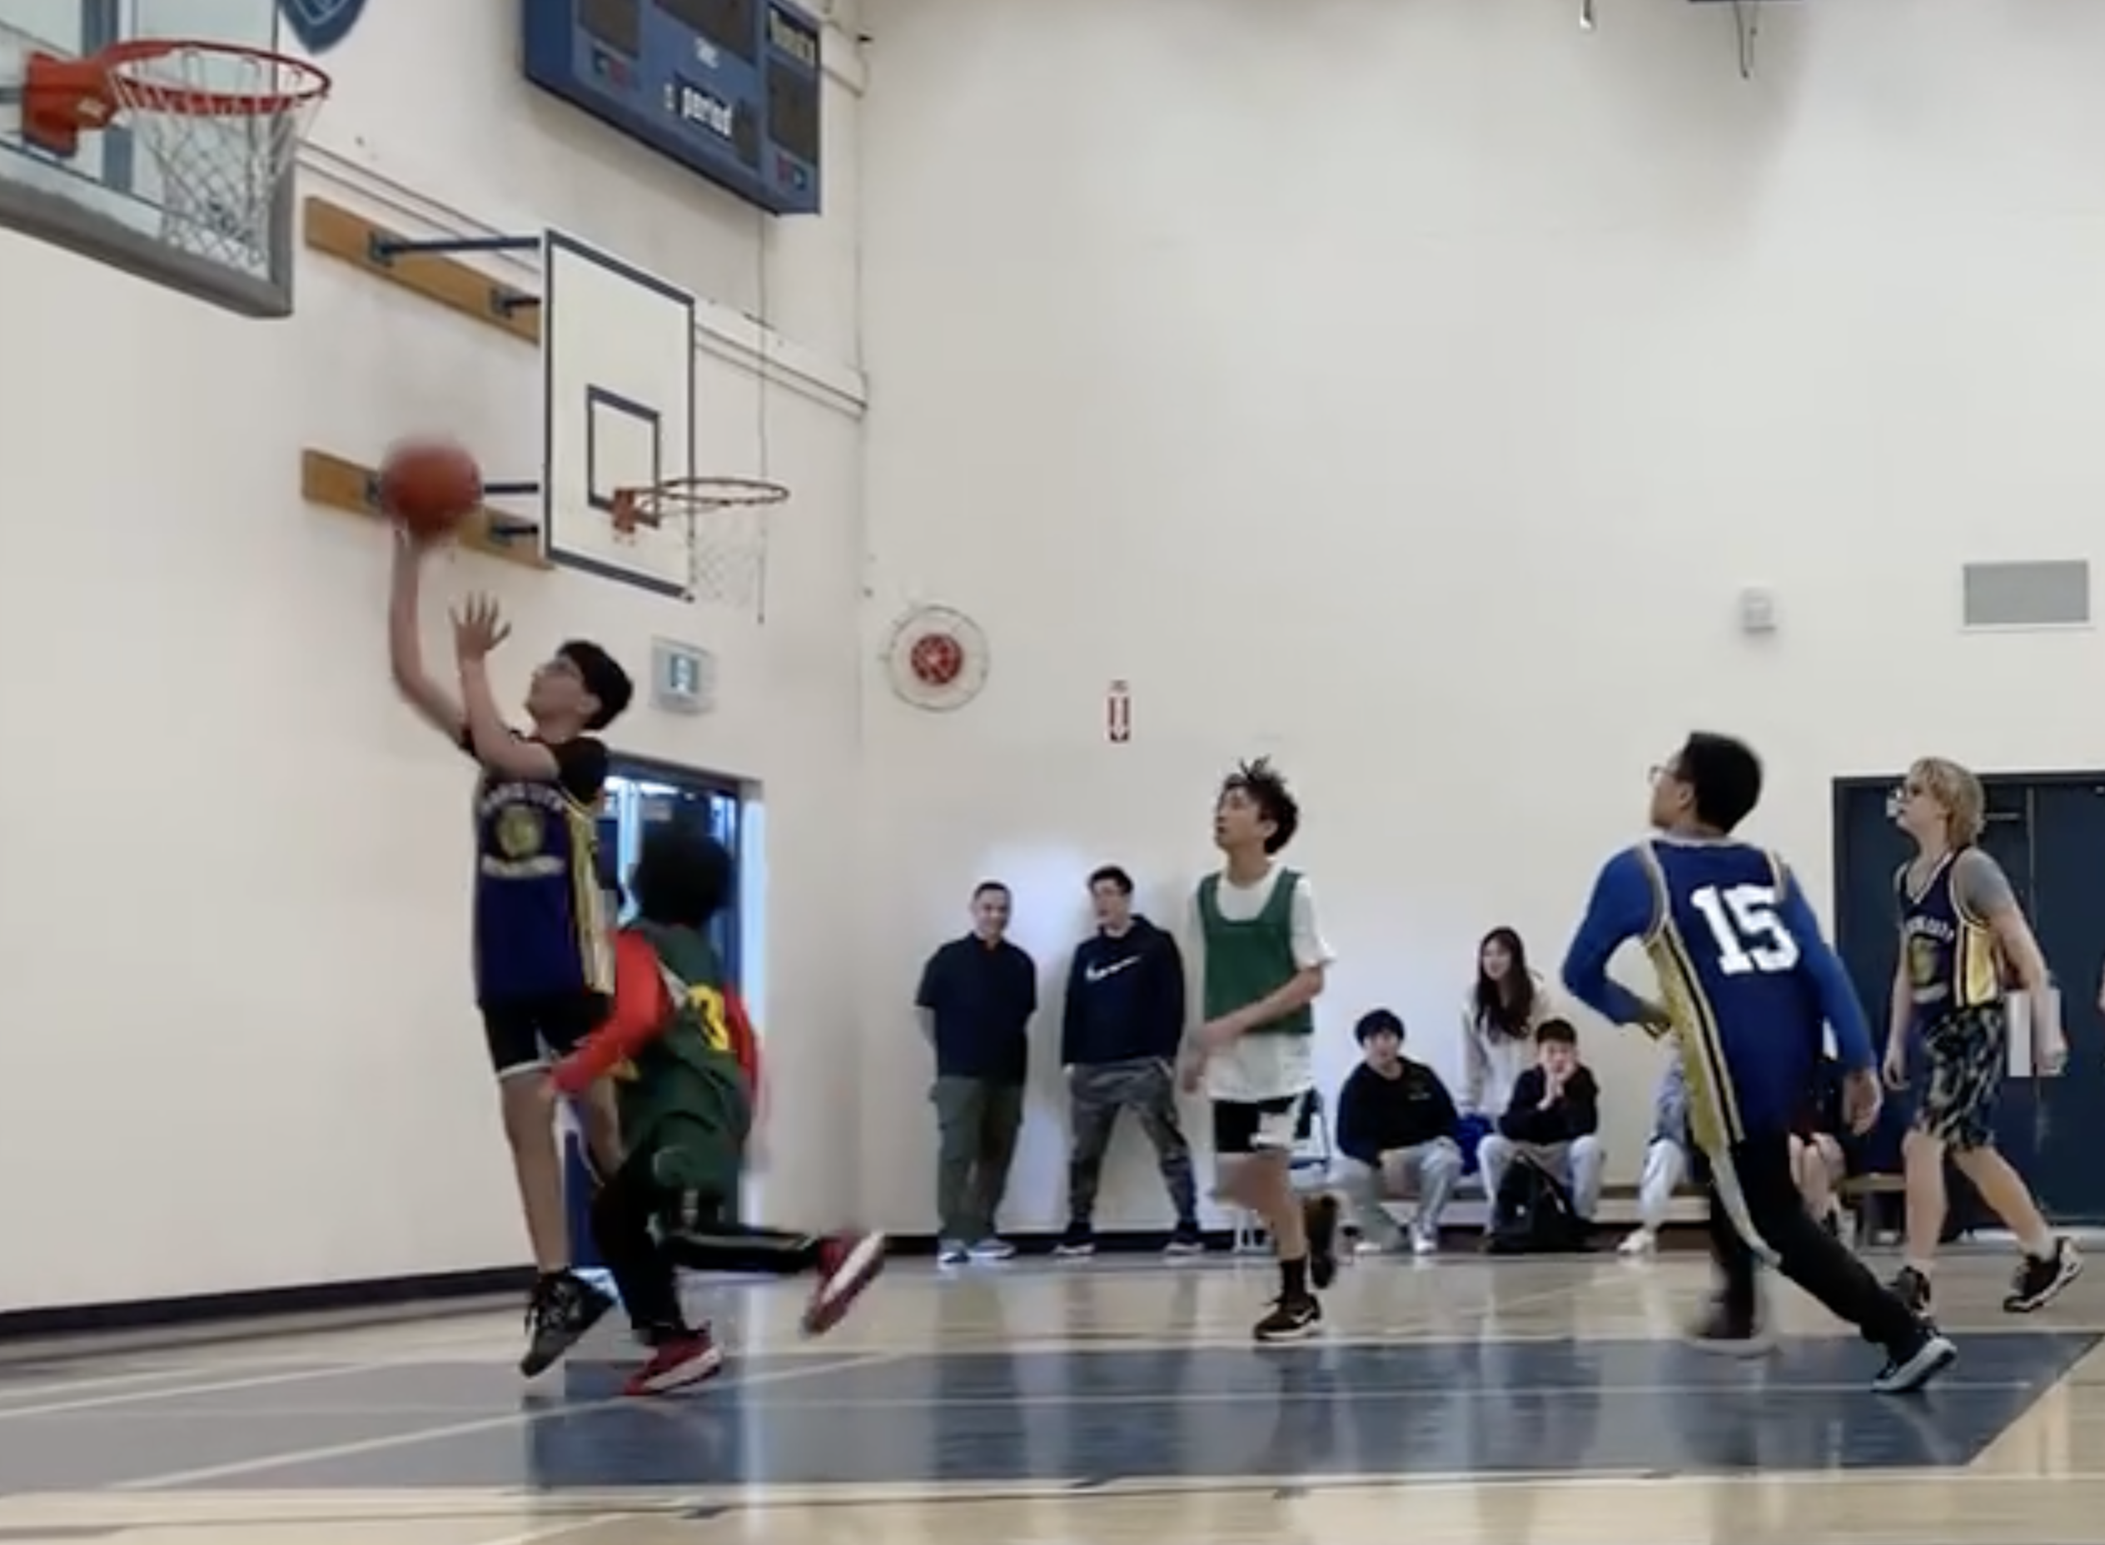
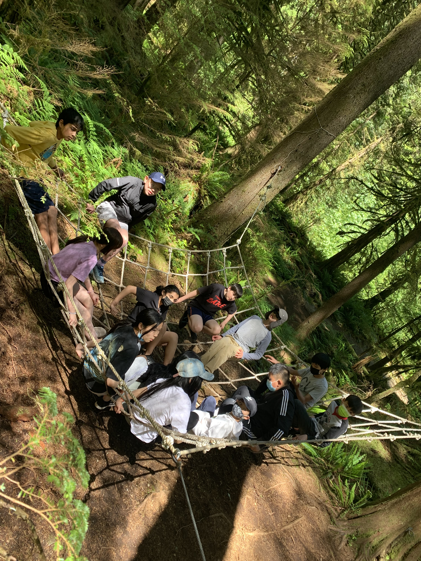
6) Together, we will build our resilience and ability to solve problems in many forms.

Slide 8
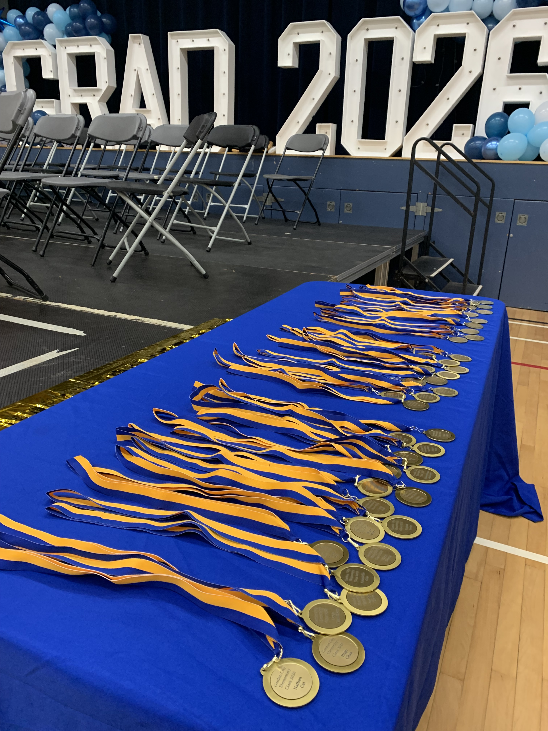
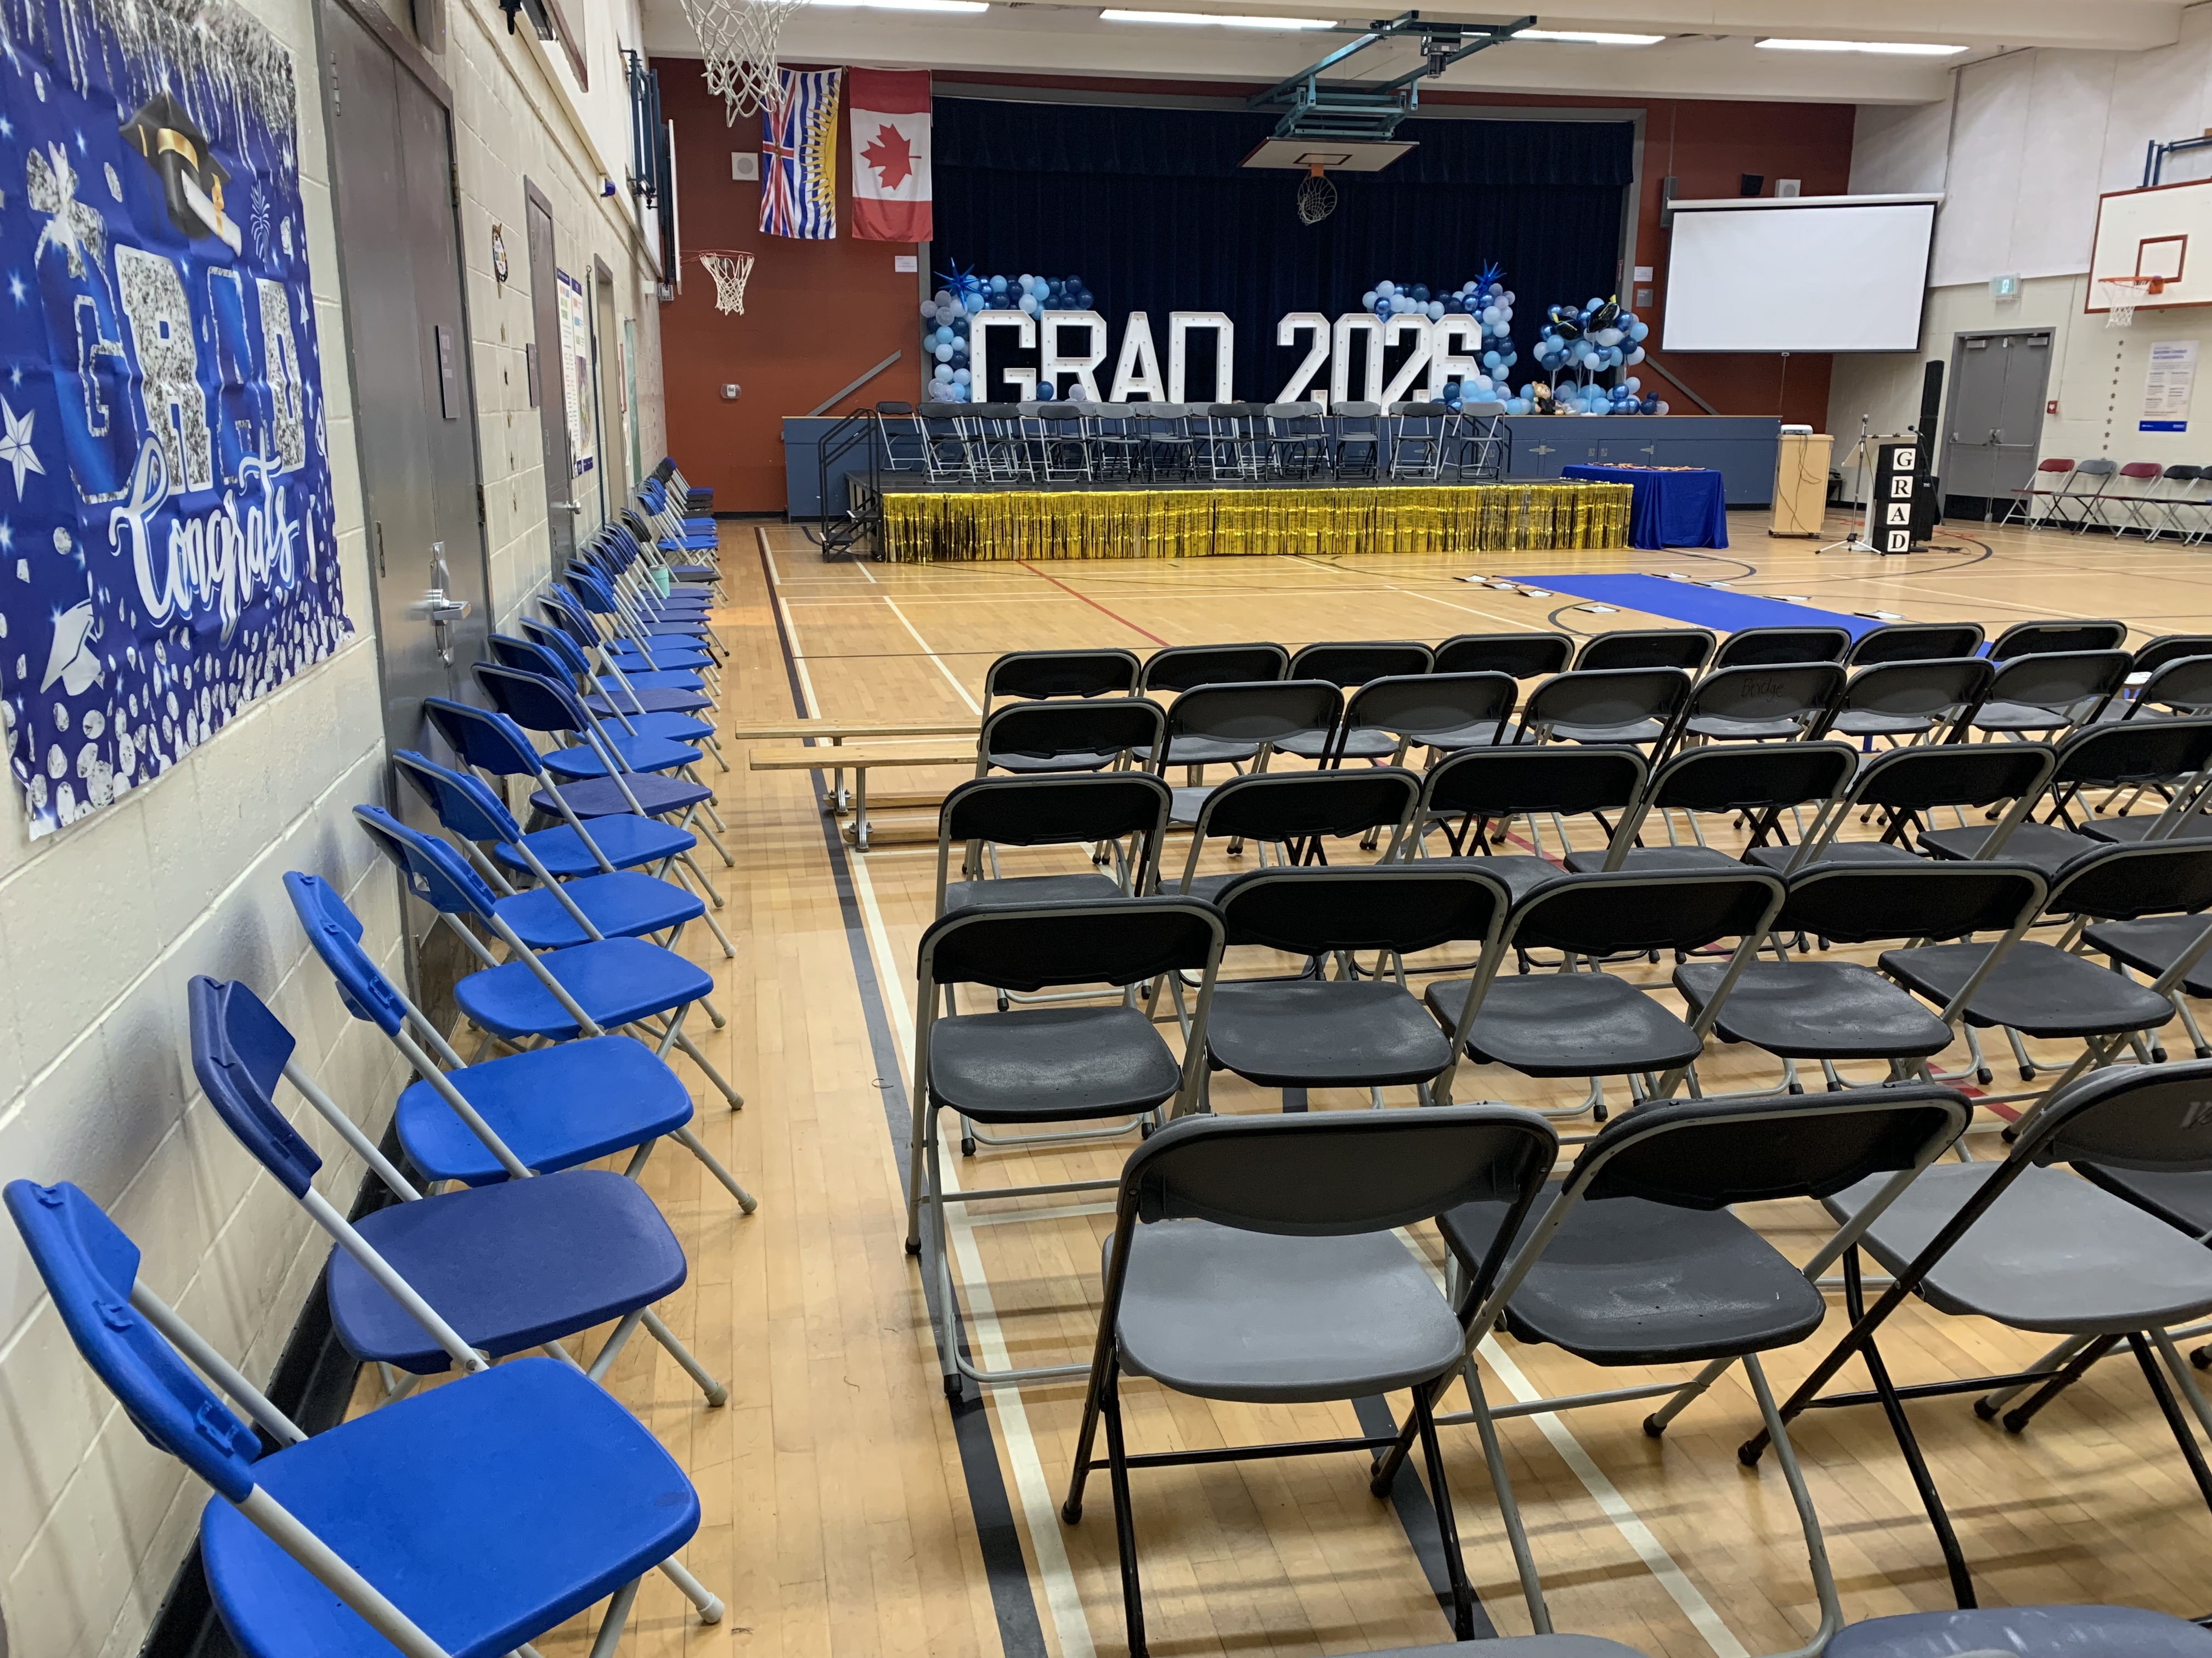
If School does not help prepare you for life, we are doing it all wrong.

